Slide 1
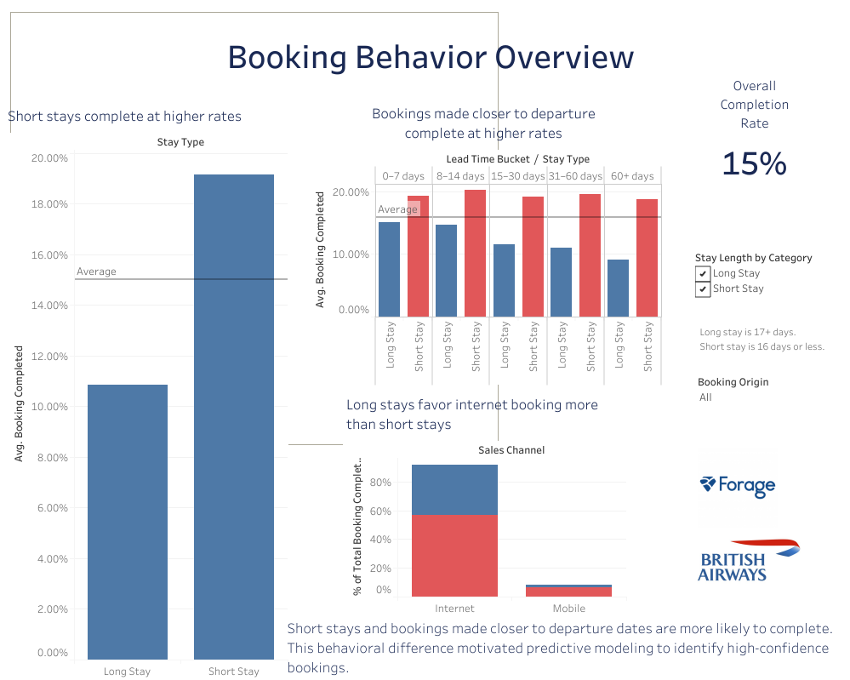
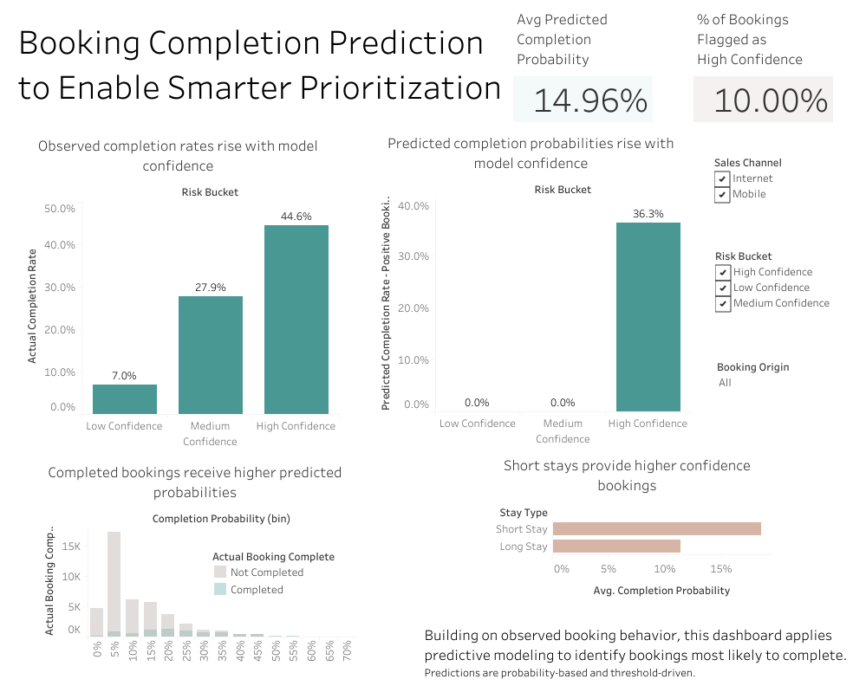
Completed Booking Project Summary - EDA and Predictive Modeling
Prepared by Hannah Bennett for the British Airways Executive Team (Forage Project)
The objective was to develop a machine learning model to estimate booking completion likelihood and support prioritization of high-confidence bookings.
This report summarizes the completed project, including the exploratory data analysis and predictive modeling.
This dataset included data on approximately 50,000 historical bookings. After identifying a median length of stay of 17 days, bookings were segmented into two categories: long stays (17 days or more) and short stays (16 days or fewer). The data was then categorized and analyzed further.
Following the exploratory data analysis, a predictive model was developed, trained, and cross-validated. The model was intentionally conservative and tuned for preciseness.
EDA Analysis Summary Tableau Dashboard - Link
Exploratory analysis highlighted meaningful differences in booking behavior than can inform future marketing strategies.
The predictive model builds on these insights by identifying and approximately 10% of bookings as high confidence. This segment completes bookings at significantly higher rates and can be prioritized for targeted marketing.
Predictive Model Tableau Dashboard - Link
Short stays and stays that are booked closer to departure date complete at higher rates
Long stays are more frequently booked via internet channels compared to short stays.
The model effectively ranks bookings by completion likelihood, with higher confidence corresponding to higher completion rates.
Completed bookings receive higher predicted probabilities than non-completed bookings.
Roughly 10% of total bookings were flagged as high confidence bookings.

